Slide 1
Programming Using the Message-Passing Paradigm
Ch. Usman Ghous

Slide 2
Introduction
Numerous programming languages and libraries have been developed for explicit parallel programming.
These differ in their view of the address space that they make available to the programmer, the degree of synchronization imposed on concurrent activities, and the multiplicity of programs.
The message-passing programming paradigm is one of the oldest and most widely used approaches for programming parallel computers.
Its roots can be traced back in the early days of parallel processing and its wide-spread adoption can be attributed to the fact that it imposes minimal requirements on the underlying hardware.

Slide 3
Principles of Message-Passing Programming
Section 6.1

Slide 4
Principles of Message-Passing Programming
There are two key attributes that characterize the message-passing programming paradigm.
The first is that it assumes a partitioned address space and the second is that it supports only explicit parallelization.
The logical view of a machine supporting the message-passing paradigm consists of p processes, each with its own exclusive address space.
Instances of such a view come naturally from clustered workstations and non-shared address space multicomputers.

Slide 5
Principles of Message-Passing Programming
There are two immediate implications of a partitioned address space.
First, each data element must belong to one of the partitions of the space; hence, data must be explicitly partitioned and placed.
This adds complexity to programming but encourages locality of access that is critical for achieving high performance on non-UMA architecture, since a processor can access its local data much faster than non-local data on such architectures.
The second implication is that all interactions (read-only or read/write) require cooperation of two processes – the process that has the data and the process that wants to access the data.
This requirement for cooperation adds a great deal of complexity for a number of reasons.
The process that has the data must participate in the interaction even if it has no logical connection to the events at the requesting process.

Slide 6
Principles of Message-Passing Programming
In certain circumstances, this requirement leads to unnatural programs.
However, a primary advantage of explicit two-way interactions is that the programmer is fully aware of all the costs of non-local interactions, and is more likely to think about algorithms (and mappings) that minimize interactions.
Another major advantage of this type of programming paradigm is that it can be efficiently implemented on a wide variety of architectures.

Slide 7
Message passing paradigm. pros and cons
The message-passing programming paradigm requires that the parallelism is coded explicitly by the programmer.
That is, the programmer is responsible for analyzing the underlying serial algorithm/application and identifying ways by which he or she can decompose the computations and extract concurrency.
As a result, programming using the message-passing paradigm tends to be hard and intellectually demanding.
However, on the other hand, properly written message-passing programs can often achieve very high performance and scale to a very large number of processes.

Slide 8
Structure of Message-Passing Programs
Message-passing programs are often written using the asynchronous or loosely synchronous paradigms.
In the asynchronous paradigm, all concurrent tasks execute asynchronously.
This makes it possible to implement any parallel algorithm.
However, such programs can be harder to reason about, and can have nondeterministic behavior due to race conditions.
Loosely synchronous programs are a good compromise between these two extremes.
In such programs, tasks or subsets of tasks synchronize to perform interactions.
However, between these interactions, tasks execute completely asynchronously.
Since the interaction happens synchronously, it is still quite easy to reason about the program.

Slide 9
Structure of Message-Passing Programs
In its most general form, the message-passing paradigm supports execution of a different program on each of the p processes.
This provides the ultimate flexibility in parallel programming but makes the job of writing parallel programs effectively unscalable.
For this reason, most message-passing programs are written using the single program multiple data (SPMD) approach.
In SPMD programs the code executed by different processes is identical except for a small number of processes (e.g., the "root" process).
In an extreme case, even in an SPMD program, each process could execute a different code (the program contains a large case statement with code for each process).
But except for this degenerate case, most processes execute the same code.
SPMD programs can be loosely synchronous or completely asynchronous.

Slide 10
The Building Blocks: Send and Receive Operations
Section 6.2

Slide 11
The Building Blocks: Send and Receive Operations
Since interactions are accomplished by sending and receiving messages, the basic operations in the message-passing programming paradigm are send and receive .
In their simplest form, the prototypes of these operations are defined as follows:
send(void *sendbuf, int nelems, int dest)
receive(void *recvbuf, int nelems, int source)
The sendbuf points to a buffer that stores the data to be sent, recvbuf points to a buffer that stores the data to be received, nelems is the number of data units to be sent and received, dest is the identifier of the process that receives the data, and source is the identifier of the process that sends the data.

Slide 12
The Building Blocks: Send and Receive Operations
But let us start with a simple example of a process sending a piece of data to another process as illustrated in the following code-fragment:
1 P0 P1
2
3 a = 100; receive(&a, 1, 0)
4 send(&a, 1, 1); printf("%d\n", a);
5 a=0;

Slide 13
The Building Blocks: Send and Receive Operations
In this simple example, process P0 sends a message to process P1 which receives and prints the message.
The important thing to note is that process P0 changes the value of a to 0 immediately following the send .
The semantics of the send operation require that the value received by process P1 must be 100 as opposed to 0.
That is, the value of a at the time of the send operation must be the value that is received by process P1 .

Slide 14
The Building Blocks: Send and Receive Operations
It may seem that it is quite straightforward to ensure the semantics of the send and receive operations.
However, based on how the send and receive operations are implemented this may not be the case.
Most message passing platforms have additional hardware support for sending and receiving messages.
They may support DMA (direct memory access) and asynchronous message transfer using network interface hardware.
Network interfaces allow the transfer of messages from buffer memory to desired location without CPU intervention.
Similarly, DMA allows copying of data from one memory location to another (e.g., communication buffers) without CPU support (once they have been programmed).

Slide 15
The Building Blocks: Send and Receive Operations
As a result, if the send operation programs the communication hardware and returns before the communication operation has been accomplished, process P1 might receive the value 0 in a instead of 100!
While this is undesirable, there are in fact reasons for supporting such send operations for performance reasons.

Slide 16
Blocking Message Passing Operations
A simple solution to the dilemma presented in the code fragment before is for the send operation to return only when it is semantically safe to do so.
Note that this is not the same as saying that the send operation returns only after the receiver has received the data.
It simply means that the sending operation blocks until it can guarantee that the semantics will not be violated on return irrespective of what happens in the program subsequently.
There are two mechanisms by which this can be achieved.

Slide 17
Blocking Non-Buffered Send/Receive
In the first case, the send operation does not return until the matching receive has been encountered at the receiving process.
When this happens, the message is sent and the send operation returns upon completion of the communication operation.
Typically, this process involves a handshake between the sending and receiving processes.
The sending process sends a request to communicate to the receiving process.
When the receiving process encounters the target receive, it responds to the request.
The sending process upon receiving this response initiates a transfer operation.
The operation is illustrated in Figure on next slide .
Since there are no buffers used at either sending or receiving ends, this is also referred to as a non-buffered blocking operation .

Slide 18
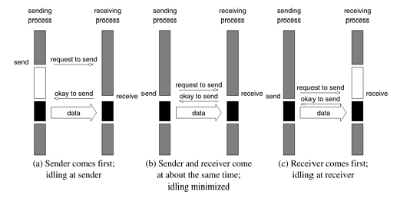
Blocking Non-Buffered Send/Receive
Notes:
Handshake for a blocking non-buffered send/receive operation. It is easy to see that in cases where sender and receiver do not reach communication point at similar times, there can be considerable idling overheads.

Slide 19
Idling Overheads in Blocking Non-Buffered Operations
In Figure on previous slide , we illustrate three scenarios in which the send is reached before the receive is posted, the send and receive are posted around the same time, and the receive is posted before the send is reached.
In cases (a) and (c), we notice that there is considerable idling at the sending and receiving process.
It is also clear from the figures that a blocking non-buffered protocol is suitable when the send and receive are posted at roughly the same time.
However, in an asynchronous environment, this may be impossible to predict.
This idling overhead is one of the major drawbacks of this protocol.

Slide 20
Deadlocks in Blocking Non-Buffered Operations
Consider the following simple exchange of messages that can lead to a deadlock:
1 P0 P1
2
3 send(&a, 1, 1); send(&a, 1, 0);
4 receive(&b, 1, 1); receive(&b, 1, 0);
The code fragment makes the values of a available to both processes P0 and P1.
However, if the send and receive operations are implemented using a blocking non-buffered protocol, the send at P0 waits for the matching receive at P1 whereas the send at process P1 waits for the corresponding receive at P0, resulting in an infinite wait.

Slide 21
Deadlocks in Blocking Non-Buffered Operations
As can be inferred, deadlocks are very easy in blocking protocols and care must be taken to break cyclic waits of the nature outlined.
In the above example, this can be corrected by replacing the operation sequence of one of the processes by a receive and a send as opposed to the other way around.
This often makes the code more cumbersome and buggier.

Slide 22
Blocking Buffered Send/Receive
A simple solution to the idling and deadlocking problem outlined above is to rely on buffers at the sending and receiving ends.
We start with a simple case in which the sender has a buffer pre-allocated for communicating messages.
On encountering a send operation, the sender simply copies the data into the designated buffer and returns after the copy operation has been completed.
The sender process can now continue with the program knowing that any changes to the data will not impact program semantics.
The actual communication can be accomplished in many ways depending on the available hardware resources.
If the hardware supports asynchronous communication (independent of the CPU), then a network transfer can be initiated after the message has been copied into the buffer.

Slide 23
Blocking Buffered Send/Receive
Note that at the receiving end, the data cannot be stored directly at the target location since this would violate program semantics.
Instead, the data is copied into a buffer at the receiver as well.
When the receiving process encounters a receive operation, it checks to see if the message is available in its receive buffer.
If so, the data is copied into the target location. This operation is illustrated in Figure on the next slide

Slide 24
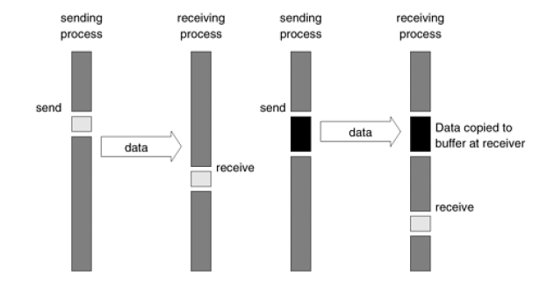
Blocking Buffered Send/Receive
Notes:
Blocking buffered transfer protocols: (a) in the presence of communication hardware with buffers at send and receive ends; and
(b) in the absence of communication hardware, sender interrupts receiver and deposits data in buffer at receiver end.

Slide 25
Blocking Buffered Send/Receive
In the protocol illustrated on previous slide, buffers are used at both sender and receiver and communication is handled by dedicated hardware.
Sometimes machines do not have such communication hardware.
In this case, some of the overhead can be saved by buffering only on one side.
For example, on encountering a send operation, the sender interrupts the receiver, both processes participate in a communication operation and the message is deposited in a buffer at the receiver end.
When the receiver eventually encounters a receive operation, the message is copied from the buffer into the target location.
This protocol is illustrated in Figure (b) on previous slide .
It is not difficult to conceive a protocol in which the buffering is done only at the sender and the receiver initiates a transfer by interrupting the sender.

Slide 26
Blocking Buffered Send/Receive
It is easy to see that buffered protocols alleviate idling overheads at the cost of adding buffer management overheads.
In general, if the parallel program is highly synchronous (i.e., sends and receives are posted around the same time), non-buffered sends may perform better than buffered sends.
However, in general applications, this is not the case and buffered sends are desirable unless buffer capacity becomes an issue.

Slide 27
Example: Impact of finite buffers in message passing
Consider the following code fragment:
1 P0 P1
2
3 for (i = 0; i < 1000; i++){ for (i = 0; i < 1000; i++) {
4 produce_data(&a); receive(&a, 1, 0);
5 send(&a, 1, 1); consume_data(&a);
6 } }

Slide 28
Example 6.1 Impact of finite buffers in message passing
In this code fragment, process P0 produces 1000 data items and process P1 consumes them.
However, if process P1 was slow getting to this loop, process P0 might have sent all of its data.
If there is enough buffer space, then both processes can proceed; however, if the buffer is not sufficient (i.e., buffer overflow), the sender would have to be blocked until some of the corresponding receive operations had been posted, thus freeing up buffer space.
This can often lead to unforeseen overheads and performance degradation.
In general, it is a good idea to write programs that have bounded buffer requirements.

Slide 29
Deadlocks in Buffered Send and Receive Operations
While buffering alleviates many of the deadlock situations, it is still possible to write code that deadlocks.
This is due to the fact that as in the non-buffered case, receive calls are always blocking (to ensure semantic consistency).
Thus, a simple code fragment such as the following deadlocks since both processes wait to receive data but nobody sends it.
1 P0 P1
2
3 receive(&a, 1, 1); receive(&a, 1, 0);
4 send(&b, 1, 1); send(&b, 1, 0);
Once again, such circular waits have to be broken. However, deadlocks are caused only by waits on receive operations in this case.

Slide 30
Non-Blocking Message Passing Operations
In blocking protocols, the overhead of guaranteeing semantic correctness was paid in the form of idling (non-buffered) or buffer management (buffered).
Often, it is possible to require the programmer to ensure semantic correctness and provide a fast send/receive operation that incurs little overhead.
This class of non-blocking protocols returns from the send or receive operation before it is semantically safe to do so.
Consequently, the user must be careful not to alter data that may be potentially participating in a communication operation.
Non-blocking operations are generally accompanied by a check-status operation, which indicates whether the semantics of a previously initiated transfer may be violated or not.
Upon return from a nonblocking send or receive operation, the process is free to perform any computation that does not depend upon the completion of the operation.
Later in the program, the process can check whether or not the non-blocking operation has completed, and, if necessary, wait for its completion.

Slide 31
Non-Blocking Message Passing Operations
As illustrated in Figure on next slide , non-blocking operations can themselves be buffered or nonbuffered.
In the non-buffered case, a process wishing to send data to another simply posts a pending message and returns to the user program.
The program can then do other useful work.
At some point in the future, when the corresponding receive is posted, the communication operation is initiated.
When this operation is completed, the check-status operation indicates that it is safe for the programmer to touch this data.
This transfer is indicated in Figure in the upcoming slides .

Slide 32
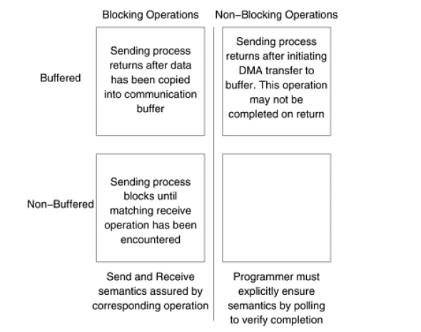
Non-Blocking Message Passing Operations
Notes:
Space of possible protocols for send and receive operations.

Slide 33
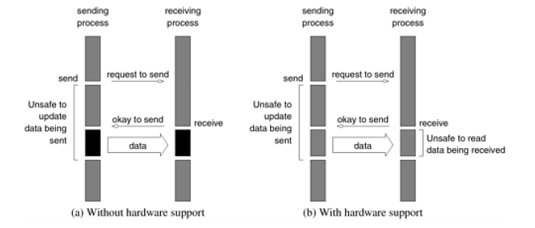
Non-Blocking Message Passing Operations
Notes:
Non-blocking non-buffered send and receive operations (a) in absence of communication hardware; (b) in presence of communication hardware.

Slide 34
Non-Blocking Message Passing Operations
Comparing Figures (a) in previous slide and first figure of this lecture (6.1 a) , it is easy to see that the idling time when the process is waiting for the corresponding receive in a blocking operation can now be utilized for computation, provided it does not update the data being sent.
This alleviates the major bottleneck associated with the former at the expense of some program restructuring.
The benefits of non-blocking operations are further enhanced by the presence of dedicated communication hardware. This is illustrated in Figure (b) on previous slide.
In this case, the communication overhead can be almost entirely masked by non-blocking operations.
In this case, however, the data being received is unsafe for the duration of the receive operation.
Notes:
Non-blocking non-buffered send and receive operations (a) in absence of communication hardware; (b) in presence of communication hardware.

Slide 35
Non-Blocking Message Passing Operations
Non-blocking operations can also be used with a buffered protocol. In this case, the sender initiates a DMA operation and returns immediately.
The data becomes safe the moment the DMA operation has been completed.
At the receiving end, the receive operation initiates a transfer from the sender's buffer to the receiver's target location.
Using buffers with nonblocking operation has the effect of reducing the time during which the data is unsafe.
Notes:
Non-blocking non-buffered send and receive operations (a) in absence of communication hardware; (b) in presence of communication hardware.

Slide 36
Non-Blocking Message Passing Operations
Typical message-passing libraries such as Message Passing Interface (MPI) and Parallel Virtual Machine (PVM) implement both blocking and non-blocking operations.
Blocking operations facilitate safe and easier programming and non-blocking operations are useful for performance optimization by masking communication overhead.
One must, however, be careful using nonblocking protocols since errors can result from unsafe access to data that is in the process of being communicated.
Notes:
Non-blocking non-buffered send and receive operations (a) in absence of communication hardware; (b) in presence of communication hardware.

Slide 37
MPI: the Message Passing Interface
Section 6.3

Slide 38
MPI: the Message Passing Interface
Parallel computers were low cost hence many libraries have been created for parallel programming.
It became so popular that it became like a modern-day assembly language where different vendors provided with their own libraries.
These libraries were compatible with their own hardware but performed poorly over other hardware.
And portability of these libraries were poor.
MPI was created to solve this problem.
MPI was a standard library that can be used to develop parallel programs in C or Fortran.

Slide 39
MPI: the Message Passing Interface
MPI library has 125 routines, but the number of key components are smaller.
Out of them the ones on the next slide are fundamental (You can write a fully functional program using them)
What do these six fundamental routines do?
Initialize and terminate the MPI library
Get information about the parallel computing environment
And obviously: to send and receive a message

Slide 40
Six Fundamental routines
Sr No: | Routine name | Description
1 | MPI_Init | Initializes MPI.
2 | MPI_Finalize | Terminates MPI.
3 | MPI_Comm_size | Determines the number of processes
4 | MPI_Comm_rank . | Determines the label of the calling process
5 | MPI_Send | Sends a message.
6 | MPI_Recv | Receives a message.

Slide 41
Starting and Terminating the MPI Library
MPI_Init is called prior to any calls to other MPI routines.
Its purpose is to initialize the MPI environment.
Calling MPI_Init more than once during the execution of a program will lead to an error.
MPI_Finalize is called at the end of the computation, and it performs various cleanup tasks to terminate the MPI environment.
No MPI calls may be performed after MPI_Finalize has been called, not even MPI_Init .
Both MPI_Init and MPI_Finalize must be called by all the processes, otherwise MPI's behavior will be undefined.

Slide 42
Starting and Terminating the MPI Library
The exact calling sequences of these two routines for C are as follows:
int MPI_Init(int *argc, char ***argv)
int MPI_Finalize()
The arguments argc and argv of MPI_Init are the command-line arguments of the C program.
An MPI implementation is expected to remove from the argv array any command-line arguments that should be processed by the implementation before returning back to the program, and to decrement argc accordingly.
Thus, command-line processing should be performed only after MPI_Init has been called.
Upon successful execution, MPI_Init and MPI_Finalize return MPI_SUCCESS ; otherwise they return an implementation-defined error code.
Notes:
The first parameter, argc (argument count) is an integer that indicates how many arguments were entered on the command line when the program was started. The second parameter, argv (argument vector), is an array of pointers to arrays of character objects.

Slide 43
Starting and Terminating the MPI Library
The bindings and calling sequences of these two functions are illustrative of the naming practices and argument conventions followed by MPI.
All MPI routines, data-types, and constants are prefixed by "MPI_ ".
The return code for successful completion is MPI_SUCCESS .
This and other MPI constants and data-structures are defined for C in the file "mpi.h" .
This header file must be included in each MPI program.

Slide 44
Communicators
A key concept used throughout MPI is that of the communication domain .
A communication domain is a set of processes that are allowed to communicate with each other.
Information about communication domains is stored in variables of type MPI_Comm ,that are called communicators .
These communicators are used as arguments to all message transfer MPI routines, and they uniquely identify the processes participating in the message transfer operation.
Note that each process can belong to many different (possibly overlapping) communication domains.

Slide 45
Communicators
The communicator is used to define a set of processes that can communicate with each other.
This set of processes form a communication domain .
In general, all the processes may need to communicate with each other.
For this reason, MPI defines a default communicator called MPI_COMM_WORLD which includes all the processes involved in the parallel execution.
However, in many cases we want to perform communication only within (possibly overlapping) groups of processes.
By using a different communicator for each such group, we can ensure that no messages will ever interfere with messages destined to any other group.
For now, it suffices to use MPI_COMM_WORLD as the communicator argument to all the MPI functions that require a communicator.

Slide 46
Getting Information
The MPI_Comm_size and MPI_Comm_rank functions are used to determine the number of processes and the label of the calling process, respectively.
The calling sequences of these routines are as follows:
int MPI_Comm_size(MPI_Comm comm, int *size)
int MPI_Comm_rank(MPI_Comm comm, int *rank)

Slide 47
Getting Information
The function MPI_Comm_size returns in the variable size the number of processes that belong to the communicator comm .
So, when there is a single process per processor, the call MPI_Comm_size(MPI_COMM_WORLD, &size) will return in size the number of processors used by the program.
Every process that belongs to a communicator is uniquely identified by its rank.
The rank of a process is an integer that ranges from zero up to the size of the communicator minus one.
A process can determine its rank in a communicator by using the MPI_Comm_rank function that takes two arguments: the communicator and an integer variable rank .

Slide 48
Getting Information
Up on return, the variable rank stores the rank of the process.
Note that each process that calls either one of these functions must belong in the supplied communicator, otherwise an error will occur.
Example 1

Slide 49
Sending and receiving messages
int MPI_Send(void *buf, int count, MPI_Datatype datatype, int dest, int tag, MPI_Comm comm)
int MPI_Recv(void *buf, int count, MPI_Datatype datatype, int source, int tag, MPI_Comm comm, MPI_Status *status)

Slide 50
Sending and receiving messages
MPI_Send sends the data stored in the buffer pointed by buf .
This buffer consists of consecutive entries of the type specified by the parameter datatype .
The number of entries in the buffer is given by the parameter count .
For all C datatypes, an equivalent MPI datatype is provided.
However, MPI allows two additional datatypes that are not part of the C language.
These are MPI_BYTE and MPI_PACKED .
Notes:
Read MPI data types from book

Slide 51
Sending and receiving messages
MPI_BYTE corresponds to a byte (8 bits) and MPI_PACKED corresponds to a collection of data items that has been created by packing non-contiguous data.
Note that the length of the message in MPI_Send , as well as in other MPI routines, is specified in terms of the number of entries being sent and not in terms of the number of bytes.
Specifying the length in terms of the number of entries has the advantage of making the MPI code portable, since the number of bytes used to store various datatypes can be different for different architectures.

Slide 52
Sending and receiving messages
The destination of the message sent by MPI_Send is uniquely specified by the dest and comm arguments.
The dest argument is the rank of the destination process in the communication domain specified by the communicator comm .
Each message has an integer-valued tag associated with it.
This is used to distinguish different types of messages.
The message-tag can take values ranging from zero up to the MPI defined constant MPI_TAG_UB .
Even though the value of MPI_TAG_UB is implementation specific, it is at least 32,767.

Slide 53
Sending and receiving messages
MPI_Recv receives a message sent by a process whose rank is given by the source in the communication domain specified by the comm argument.
The tag of the sent message must be that specified by the tag argument.
If there are many messages with identical tag from the same process, then any one of these messages is received.
MPI allows specification of wildcard arguments for both source and tag .
If source is set to MPI_ANY_SOURCE , then any process of the communication domain can be the source of the message.
Similarly, if tag is set to MPI_ANY_TAG , then messages with any tag are accepted.

Slide 54
Sending and receiving messages
The received message is stored in continuous locations in the buffer pointed to by buf .
The count and datatype arguments of MPI_Recv are used to specify the length of the supplied buffer.
The received message should be of length equal to or less than this length.
This allows the receiving process to not know the exact size of the message being sent.
If the received message is larger than the supplied buffer, then an overflow error will occur, and the routine will return the error MPI_ERR_TRUNCATE .
Notes:
Go and read table 6.2 from book to read about data types for MPI wrt to their C counterparts

Slide 55
Sending and receiving messages
After a message has been received, the status variable can be used to get information about the MPI_Recv operation.
In C, status is stored using the MPI_Status data-structure.
This is implemented as a structure with three fields, as follows:
typedef struct MPI_Status
{
int MPI_SOURCE;
int MPI_TAG;
int MPI_ERROR;
};

Slide 56
Sending and receiving messages
MPI_SOURCE and MPI_TAG store the source and the tag of the received message.
They are particularly useful when MPI_ANY_SOURCE and MPI_ANY_TAG are used for the source and tag arguments.
MPI_ERROR stores the error-code of the received message.
The status argument also returns information about the length of the received message.
This information is not directly accessible from the status variable, but it can be retrieved by calling the MPI_Get_count function.

Slide 57
Sending and receiving messages
The calling sequence of this function is as follows:
int MPI_Get_count(MPI_Status *status, MPI_Datatype datatype, int *count)
MPI_Get_count takes as arguments the status returned by MPI_Recv and the type of the received data in datatype and returns the number of entries that were actually received in the count variable.

Slide 58
Sending and receiving messages
The MPI_Recv returns only after the requested message has been received and copied into the buffer.
That is, MPI_Recv is a blocking receive operation.
However, MPI allows two different implementations for MPI_Send .
In the first implementation, MPI_Send returns only after the corresponding MPI_Recv have been issued and the message has been sent to the receiver.
In the second implementation, MPI_Send first copies the message into a buffer and then returns, without waiting for the corresponding MPI_Recv to be executed.

Slide 59
Sending and receiving messages
In either implementation, the buffer that is pointed by the buf argument of MPI_Send can be safely reused and overwritten.
MPI programs must be able to run correctly regardless of which of the two methods is used for implementing MPI_Send .
Such programs are called safe .
In writing safe MPI programs, sometimes it is helpful to forget about the alternate implementation of MPI_Send and just think of it as being a blocking send operation.

Slide 60
Avoiding Deadlocks
The semantics of MPI_Send and MPI_Recv place some restrictions on how we can mix and match send and receive operations.
For example, consider the following piece of code in which process 0 sends two messages with different tags to process 1, and process 1 receives them in the reverse order.

Slide 61
Avoiding Deadlocks
1 int a[10], b[10], myrank;
2 MPI_Status status;
3 ...
4 MPI_Comm_rank(MPI_COMM_WORLD, &myrank);
5 if (myrank == 0) {
6 MPI_Send(a, 10, MPI_INT, 1, 1, MPI_COMM_WORLD);
7 MPI_Send(b, 10, MPI_INT, 1, 2, MPI_COMM_WORLD);
8 }
9 else if (myrank == 1) {
10 MPI_Recv(b, 10, MPI_INT, 0, 2, MPI_COMM_WORLD);
11 MPI_Recv(a, 10, MPI_INT, 0, 1, MPI_COMM_WORLD);
12 }

Slide 62
Avoiding Deadlocks
If MPI_Send is implemented using buffering, then this code will run correctly provided that sufficient buffer space is available.
However, if MPI_Send is implemented by blocking until the matching receive has been issued, then neither of the two processes will be able to proceed.
This is because process zero (i.e., myrank == 0 ) will wait until process one issues the matching MPI_Recv (i.e., the one with tag equal to 1), and at the same time process one will wait until process zero performs the matching MPI_Send (i.e., the one with tag equal to 2).

Slide 63
Avoiding Deadlocks
This code fragment is not safe, as its behavior is implementation dependent.
It is up to the programmer to ensure that his or her program will run correctly on any MPI implementation.
The problem in this program can be corrected by matching the order in which the send and receive operations are issued .
Similar deadlock situations can also occur when a process sends a message to itself.
Even though this is legal, its behavior is implementation dependent and must be avoided.
Example: Odd-Even Sort

Slide 64
Topologies and Embedding
Section 6.4

Slide 65
Topologies and Embedding
MPI views the processes as being arranged in a one-dimensional topology and uses a linear ordering to number the processes.
However, in many parallel programs, processes are naturally arranged in higher-dimensional topologies (e.g., two- or three-dimensional).
In such programs, both the computation and the set of interacting processes are naturally identified by their coordinates in that topology.
For example, in a parallel program in which the processes are arranged in a two-dimensional topology, process (i , j ) may need to send message to (or receive message from) process (k , l ).
To implement these programs in MPI, we need to map each MPI process to a process in that higher-dimensional topology.

Slide 66
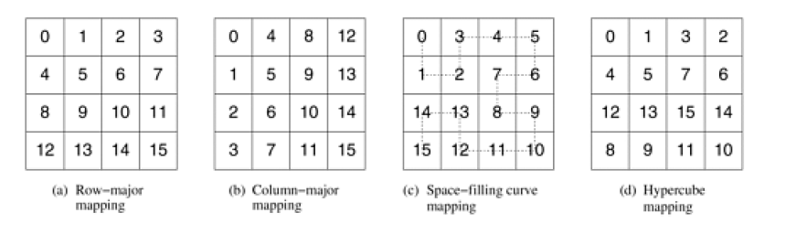
Topologies and Embedding

Slide 67
Topologies and Embedding
In general, the goodness of a mapping is determined by the pattern of interaction among the processes in the higher-dimensional topology, the connectivity of physical processors, and the mapping of MPI processes to physical processors.
For example, consider a program that uses a two-dimensional topology and each process needs to communicate with its neighboring processes along the x and y directions of this topology.
Now, if the processors of the underlying parallel system are connected using a hypercube interconnection network, then the mapping shown in Figure on previous slide (d) is better, since neighboring processes in the grid are also neighboring processors in the hypercube topology.

Slide 68
Topologies and Embedding
However, the mechanism used by MPI to assign ranks to the processes in a communication domain does not use any information about the interconnection network, making it impossible to perform topology embeddings in an intelligent manner.
Furthermore, even if we had that information, we will need to specify different mappings for different interconnection networks, diminishing the architecture independent advantages of MPI.
A better approach is to let the library itself compute the most appropriate embedding of a given topology to the processors of the underlying parallel computer.

Slide 69
Topologies and Embedding
This is exactly the approach facilitated by MPI.
MPI provides a set of routines that allows the programmer to arrange the processes in different topologies without having to explicitly specify how these processes are mapped onto the processors.
It is up to the MPI library to find the most appropriate mapping that reduces the cost of sending and receiving messages.

Slide 70
Broadcast
The one-to-all broadcast operation described in Section 4.1 is performed in MPI using the MPI_Bcast function.
int MPI_Bcast(void *buf, int count, MPI_Datatype datatype, int source, MPI_Comm comm)
MPI_Bcast sends the data stored in the buffer buf of process source to all the other processes in the group.
The data received by each process is stored in the buffer buf .
The data that is broadcast consist of count entries of type datatype .
The amount of data sent by the source process must be equal to the amount of data that is being received by each process; i.e., the count and datatype fields must match on all processes.

Slide 71
Reduction
The all-to-one reduction operation described in Section 4.1 is performed in MPI using the MPI_Reduce function.
int MPI_Reduce(void *sendbuf, void *recvbuf, int count, MPI_Datatype datatype, MPI_Op op, int target, MPI_Comm comm)
MPI_Reduce combines the elements stored in the buffer sendbuf of each process in the group, using the operation specified in op and returns the combined values in the buffer recvbuf of the process with rank target .
Both the sendbuf and recvbuf must have the same number of count items of type datatype .
Note that all processes must provide a recvbuf array, even if they are not the target of the reduction operation.
When count is more than one, then the combine operation is applied element-wise on each entry of the sequence.
All the processes must call MPI_Reduce with the same value for count , datatype , op , target , and comm .

Slide 72
Reading assignment
Look for
predefined reduction operations
MinLoc and MaxLoc
Gather Scatter
All to All personalized communication for MPI

Slide 73
Coding Demos
Matrix Vector Multiplication
Broadcast
Reduce
Sample Sort
Scatter
Gather
All to ALL personalized communication

